Slide 1
Python Codespace Template
Create or extend a ready-to-use repository for teaching Python in minutes
Notes:
With this template repository you can quickly create a normalized environment to teach or learn Python. Make your students focus on learning rather than setting up their environment. This template uses Codespaces, a development environment that's hosted in the cloud with Visual Studio Code, a powerful text editor.

Slide 3



Codespaces features
Repeatable cloud environment offering a push-button experience.
Can be configured and customized.
Integrates with your repositories on GitHub and VSCode
Notes:
Codespaces features:
Repeatable cloud environment offering a push-button experience.
Can be configured and customized.
Integrates with your repositories on GitHub and VSCode
As a teacher that means that you can create an environment, in the cloud, for your class that all students can use with zero or next to zero configuration regardless of what operating system they are using.

Slide 4
Customization
Notes:
Customize your project for GitHub Codespaces by committing configuration files to your repository (often known as Configuration-as-Code), which creates a repeatable codespace configuration for all users of your project.

Slide 5



Extensions
Dotfiles and settings
Operating system libraries and dependencies
Notes:
You can configure things like:
Extensions, you can specify what extensions should be preinstalled.
Dotfiles and settings.
Operating system libraries and dependencies

Slide 6
Codespaces template
microsoft/codespaces-teaching-template-py: Codespaces template for teaching Python (github.com)
Notes:
This repo is a GitHub template. It contains the following

Slide 7


example-notebook.ipynb
.devcontainer/Dockerfile
.devcontainer/devcontainer.json
README.md
Codespaces template
Notes:
example-notebook.ipynb, This notebook uses the Pandas library to teach basic operations with a small CSV (Comma Separated Value file) dataset
.devcontainer/Dockerfile, So that you can configure what operating system the Codespace will use and how should the container be built.
.devcontainer/devcontainer.json, A configuration file used by Codespaces to configure Visual Studio Code, for example to add and enable an extension.
README.md. This file describes this repository and what's in it.

Slide 8
Found an issue?
Help us make this template repository better by letting us know and opening an issue!.

Slide 9

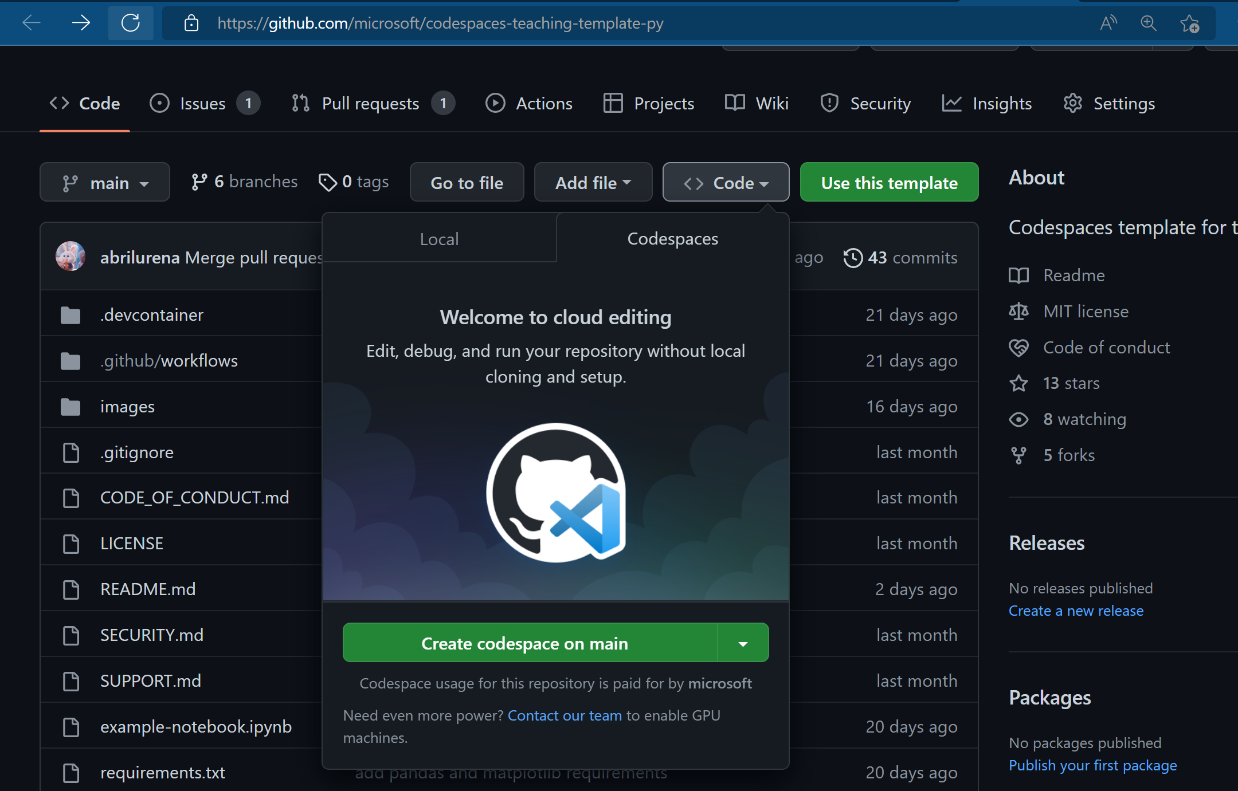



Try it out
following these steps:
Create a repo from this template.
Use this create repo link
Navigate to the main page of the newly created repository.
Under the repository name, use the Code drop-down menu, and in the Codespaces tab, select "Create codespace on main".
Notes:
Try out this template repository using Codespaces following these steps:
Create a repo from this template. Use this create repo link
Navigate to the main page of the newly created repository.
Under the repository name, use the Code drop-down menu, and in the Codespaces tab, select "Create codespace on main".

Slide 10
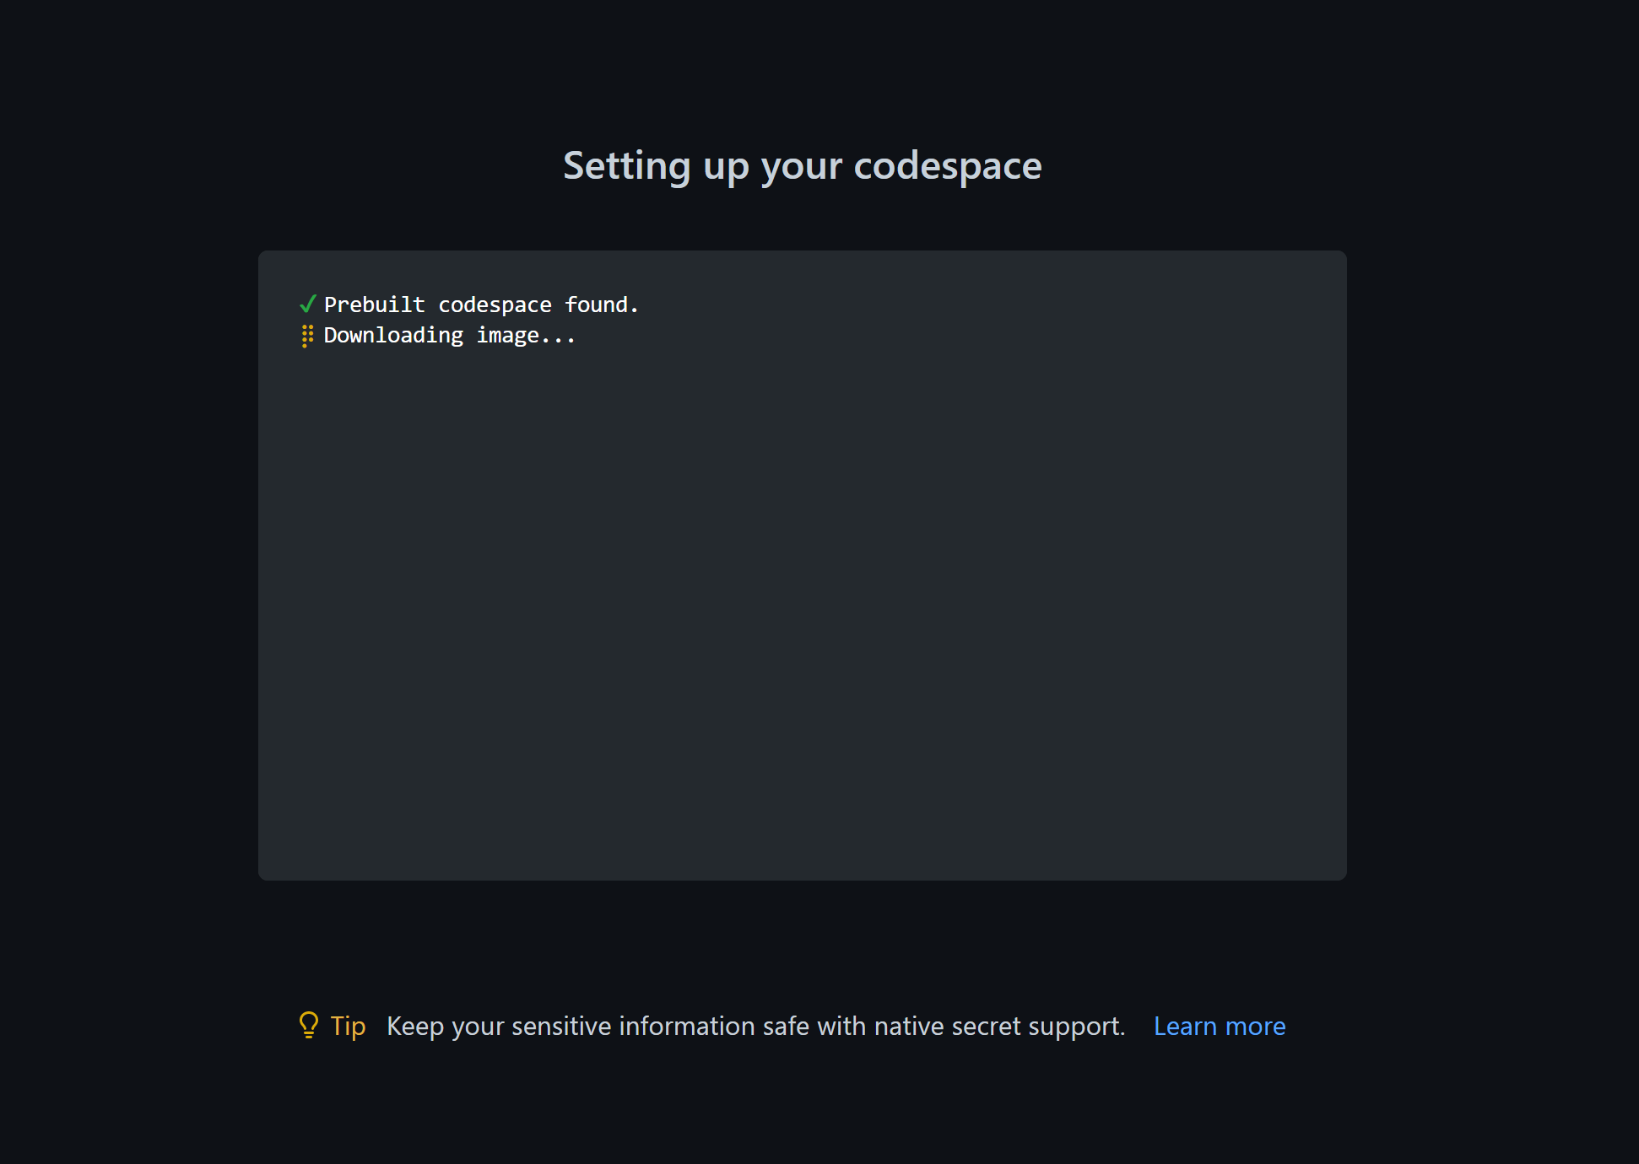
Your screen will look like this
Notes:
4. Creating codespace

Slide 11









Customize your
Codespace
build
code
test
plan
release
monitor
deploy
operate

Slide 12
Customize your Codespace
1. Change the Python version installed
2. Add an extension
Notes:
Let's make changes to your environment. We'll cover two different challenges that you are likely to want to do:
Change the Python version installed
Add an extension

Slide 13

Option 1
Open .devcontainer/devcontainer.json and replace the following section:
“VARIANT”: “3.8-bullseye”
With the following instruction:
Change the Python environment
"VARIANT": "3.9-bullseye"
Notes:
Let's say you want to change what version of Python is installed. This is something you can control.
Open .devcontainer/devcontainer.json and replace the following section:
"VARIANT": "3.8-bullseye"
with the following instruction:
"VARIANT": "3.9-bullseye“
this change will use Python 3.9 instead of 3.8.

Slide 14

Option 2:
Add an extension
1. Open file .devcontainer/devcontainer.json and locate the following JSON element extensions:
"extensions": [
"ms-python.python",
"ms-python.vscode-pylance"
]
Notes:
Your environment comes with preinstalled extensions. You can change which extensions your codespaces environment starts with, here's how:
Open file .devcontainer/devcontainer.json and locate the following JSON element extensions:
"extensions": [
"ms-python.python",
"ms-python.vscode-pylance"
]

Slide 15
Option 2:
Add an extension
2. Add "ms-python.black-formatter" to the list of extensions. It should end up looking like the following:
"extensions": [
"ms-python.python",
"ms-python.vscode-pylance",
"ms-python.black-formatter"
]
Notes:
2. Add "ms-python.black-formatter" to the list of extensions. It should end up looking like the following:
"extensions": [
"ms-python.python",
"ms-python.vscode-pylance",
"ms-python.black-formatter"
]
What you did above was to add the unique identifier of an extension of the Python Black Formatter extension. This will let Codespaces know that this extension should be pre-installed upon startup.

Slide 16

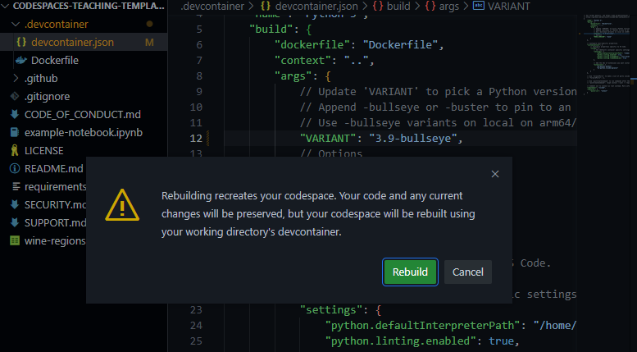
Remainder: When you change any configuration on the json, a box will appear after saving.
Notes:
Remainder: When you change any configuration on the json, a box will appear after saving.
Click on rebuild. Wait for your codespace to rebuild the VS Code environment.

Slide 17

Unique identifier of an extension
Navigate to the extension's web page
for example, Black Formatter.
To find the
Locate the Unique Identifier field
Under More info section on your right side.
Notes:
To find the unique identifier of an extension:
Navigate to the extension's web page, for example https://marketplace.visualstudio.com/items?itemName=ms-python.black-formatter
Locate the Unique Identifier field under More info section on your right side.

Slide 18

Learn more
GitHub Codespaces docs overview
GitHub Codespaces docs quickstart

